Slide 1
LIST OF SENSORS

Slide 2
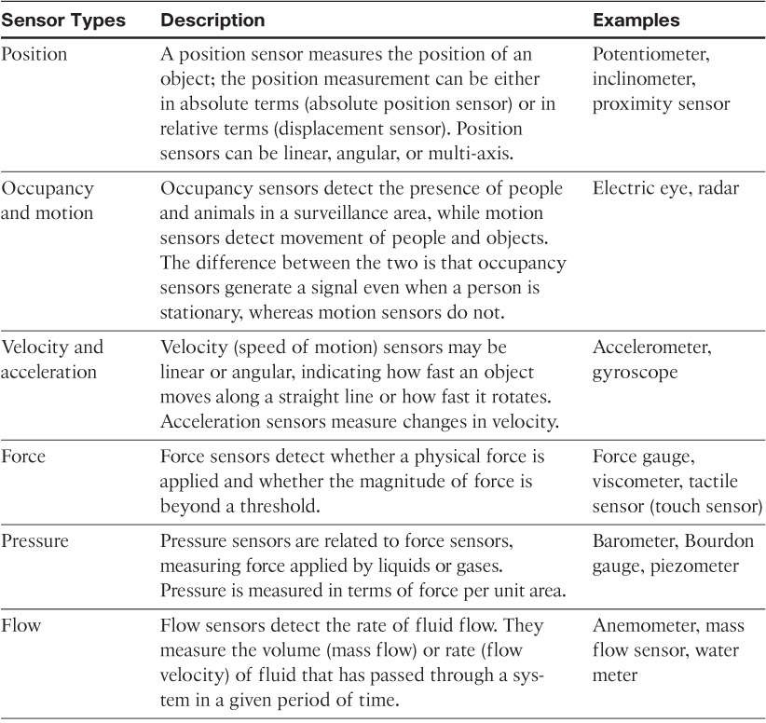

Slide 3
